Slide 1
British Airways Sentiment Analysis
By
Oluwatosin Adeoye

Slide 2
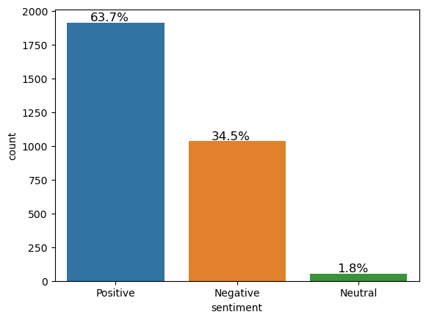
Reviews grouped according to Sentiments
From the 3000 reviews scrapped, 63.7% are Positive, 34.5% are negative and 1.8% are Neutral

Slide 3
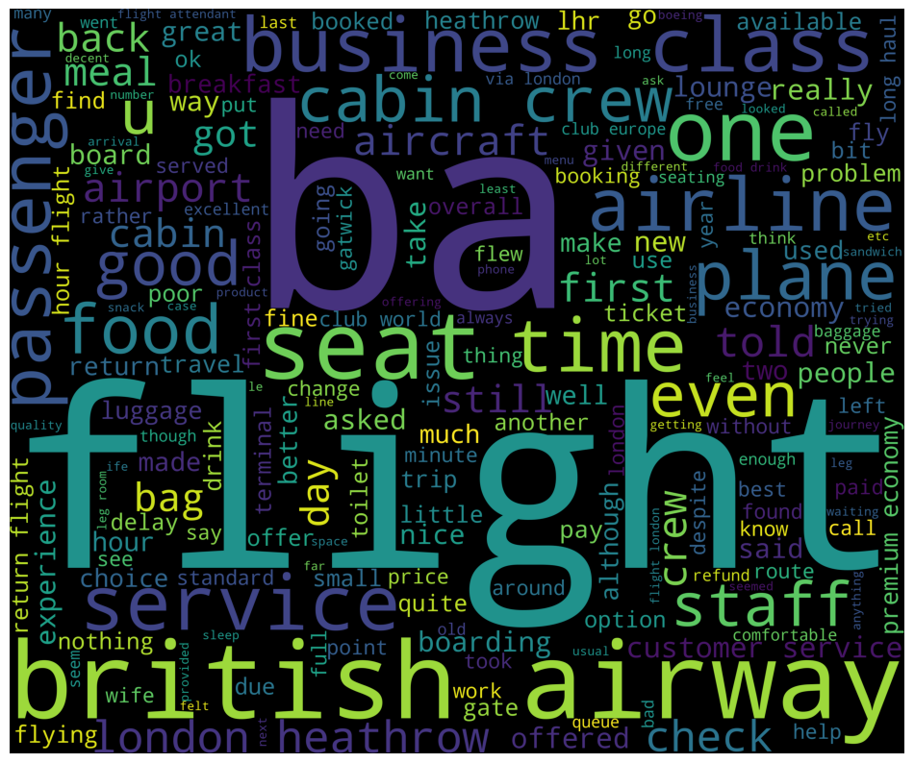
Word Cloud and Word Frequency
Words | Frequency
Flight | 5672
Ba | 3980
Service | 2378
British | 2061
London | 2044
Seat | 1877
Food | 1827
Time | 1712
Crew | 1691

